Slide 1
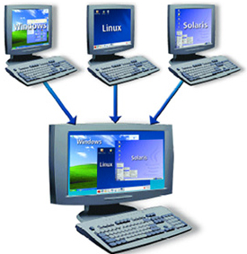
Deploying Docker Containers
Docente: Dott. Daniele Gobbo Modulo 1

Slide 2
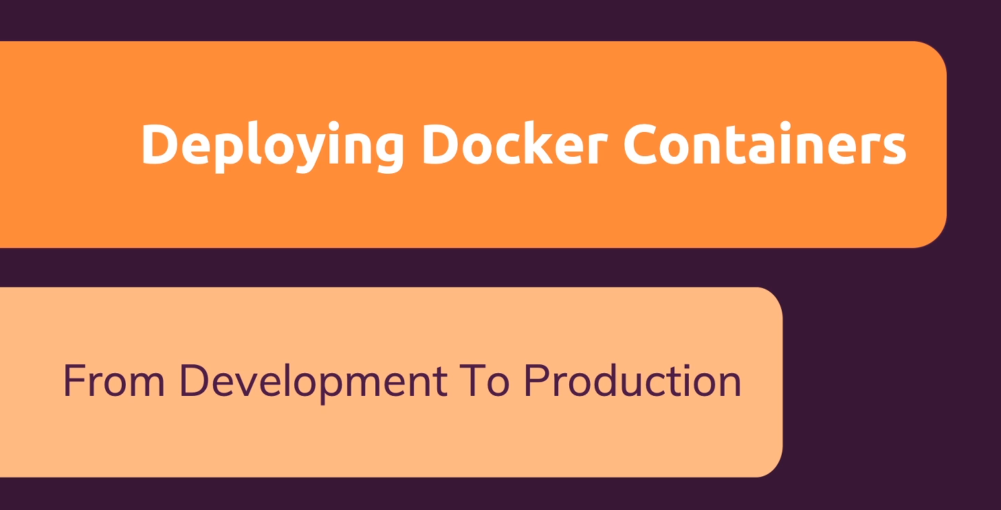

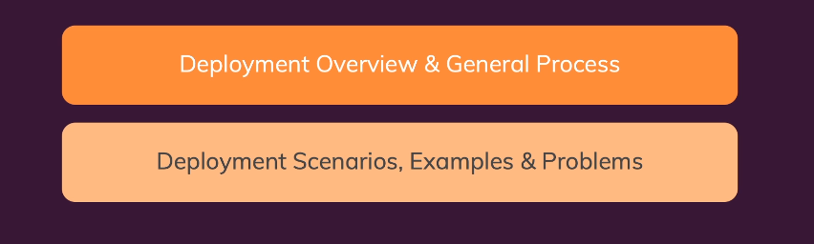
DEPLOYING DOCKER CONTAINERS
We will not just work with them on our local host machine, but we will use what we learned over the last presentations to run containers on remote machines.
So on machines running in the cloud, in the web, which are then also reachable by the users you want to reach
We will understand:
what deploying containers means
what you should keep in mind
which steps you could follow
to deploy your containerized application.

Slide 3
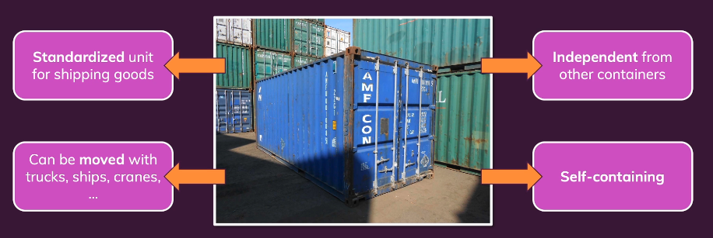
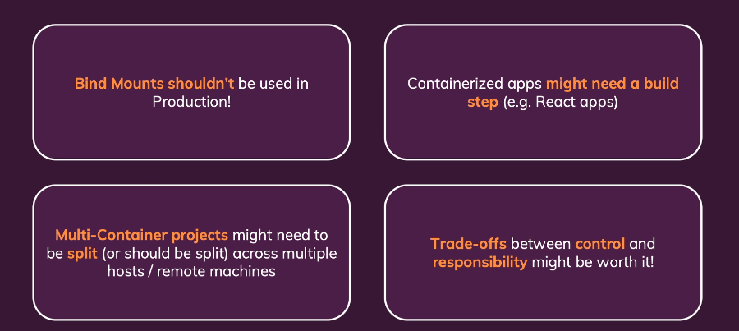
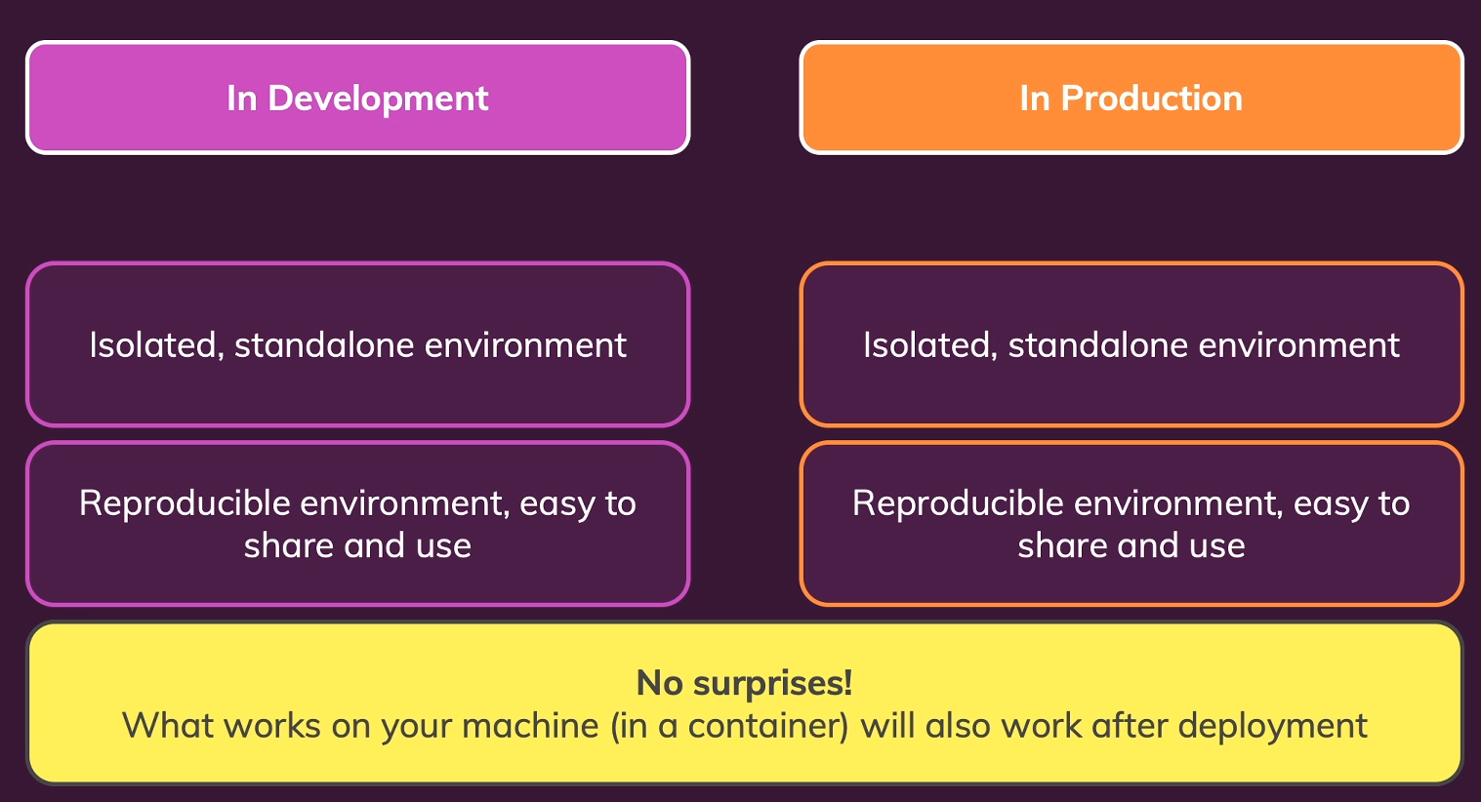
FROM DEVELOPMENT TO PRODUCTION

Slide 4
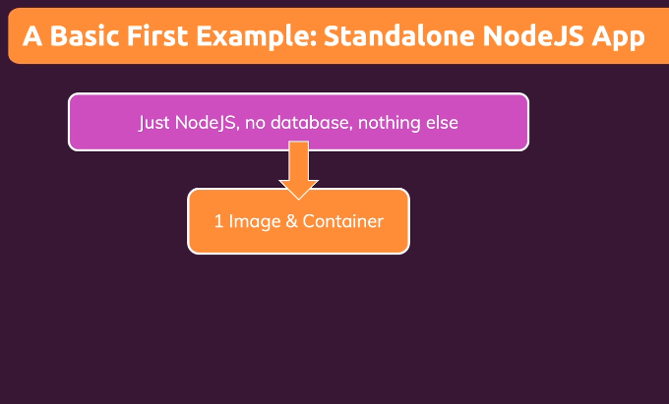
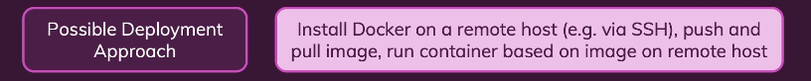
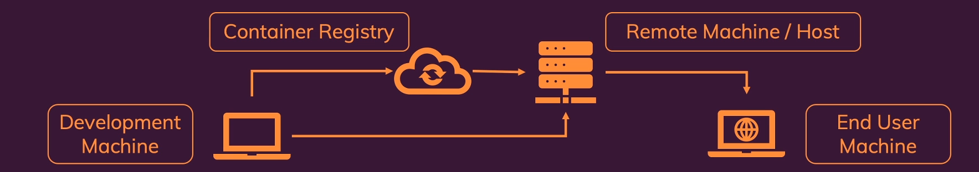
DEPLOYMENT PROCCESS AND PROVIDER

Slide 5
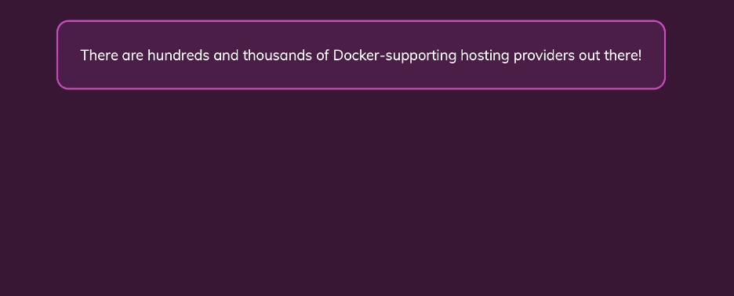
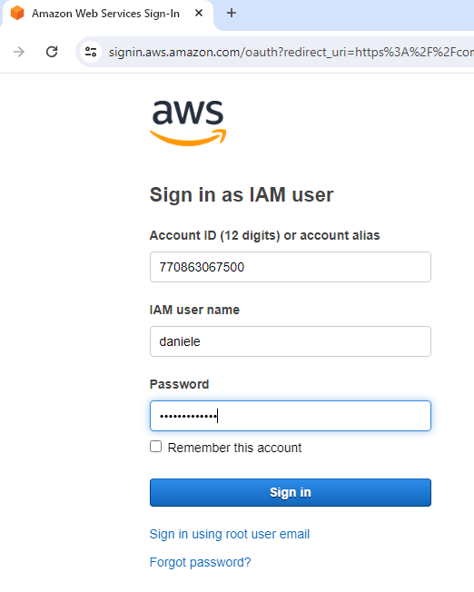
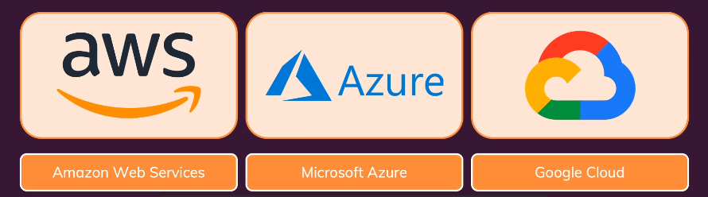
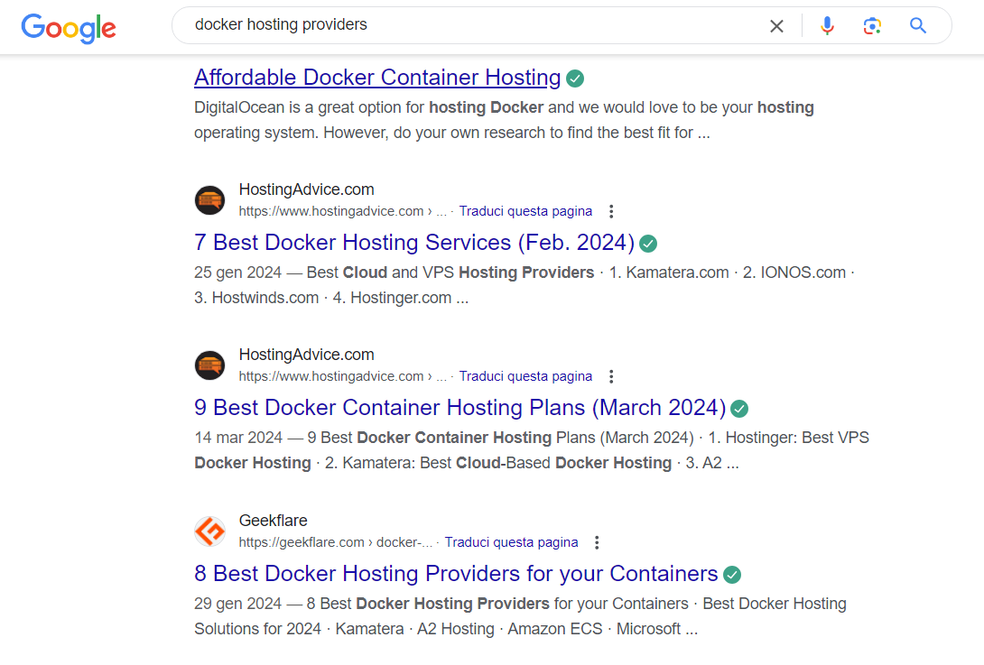
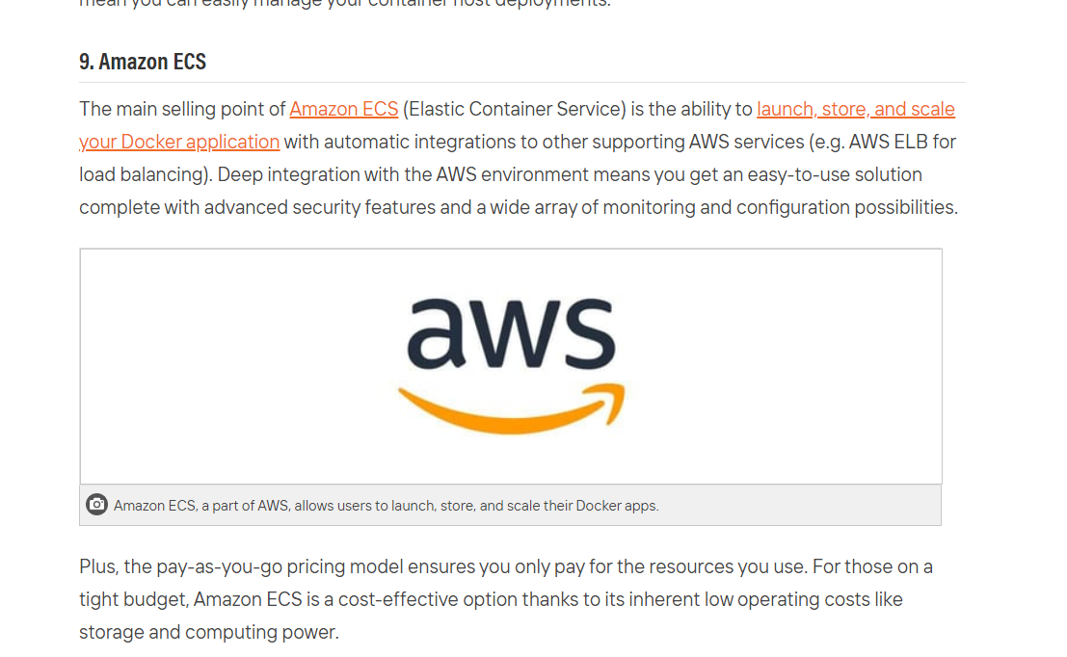
HOSTING PROVDERS
I will show you different ways
of bringing your Docker containers to live on AWS

Slide 6
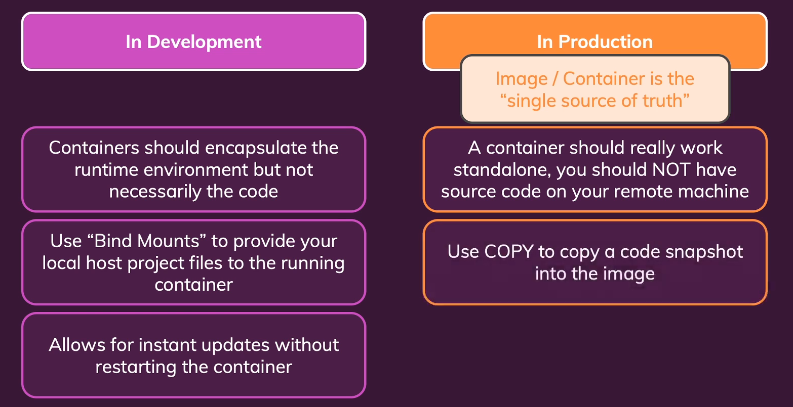
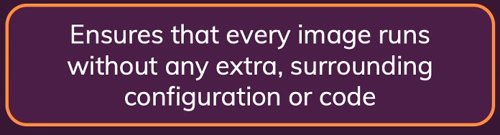
Bind Mounts, Volumes & COPY

Slide 7
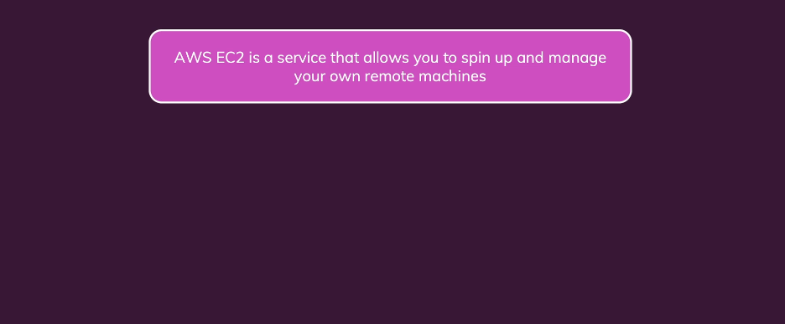
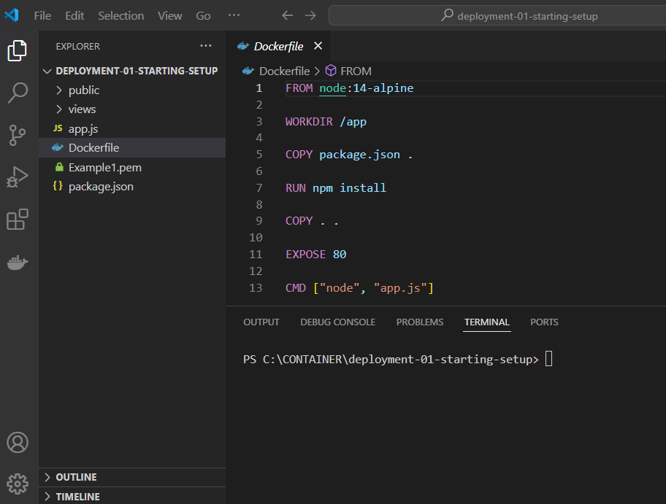
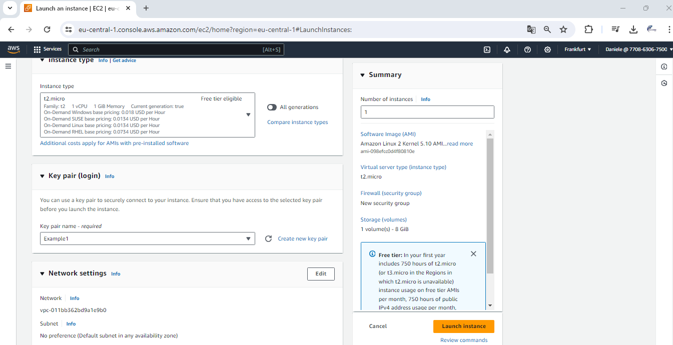
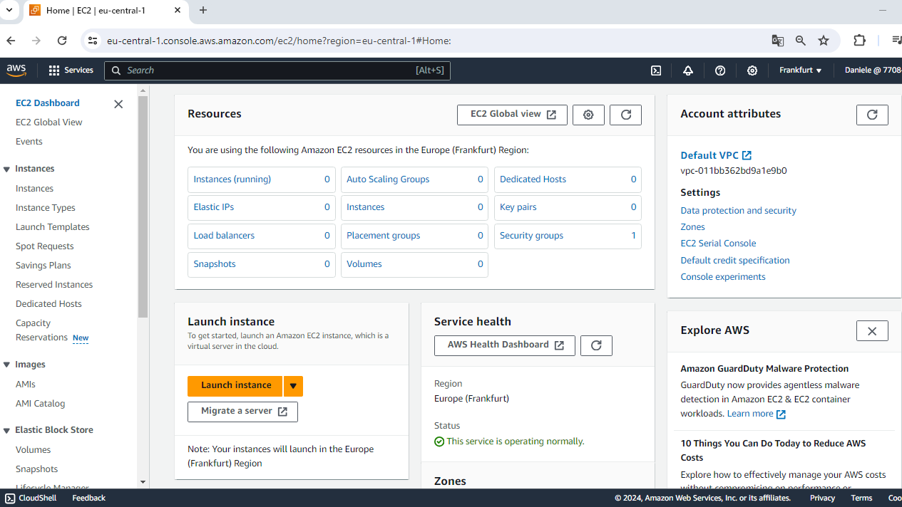
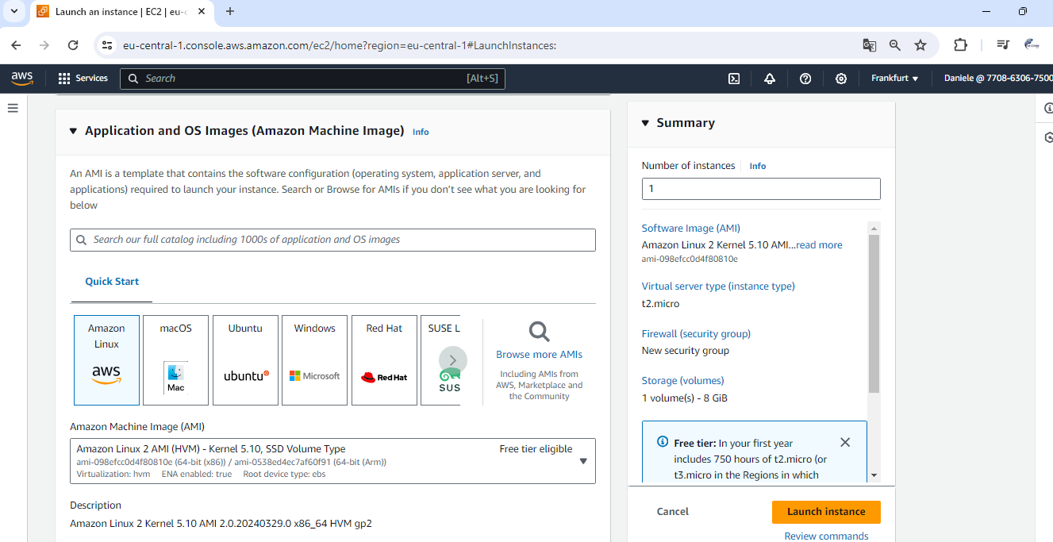
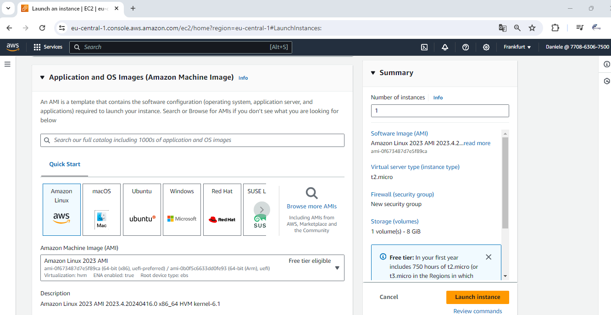
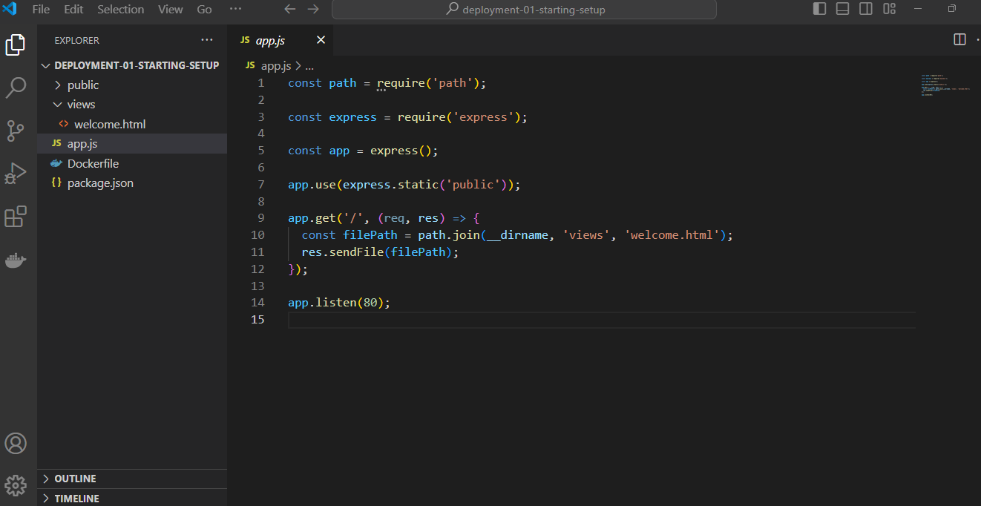
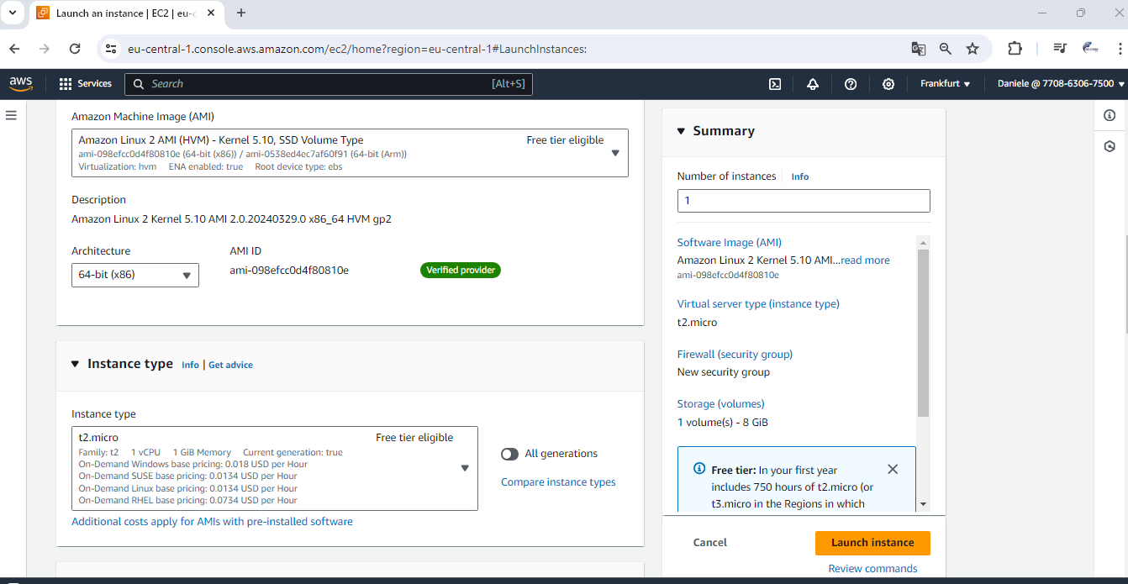
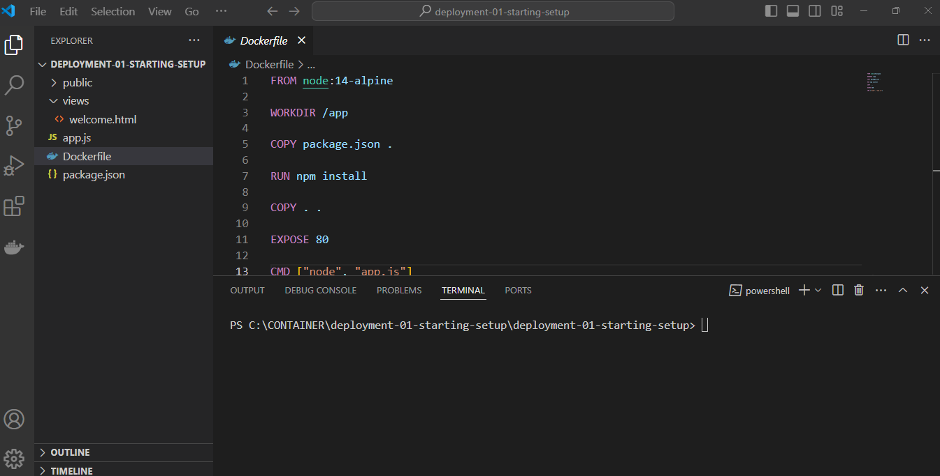
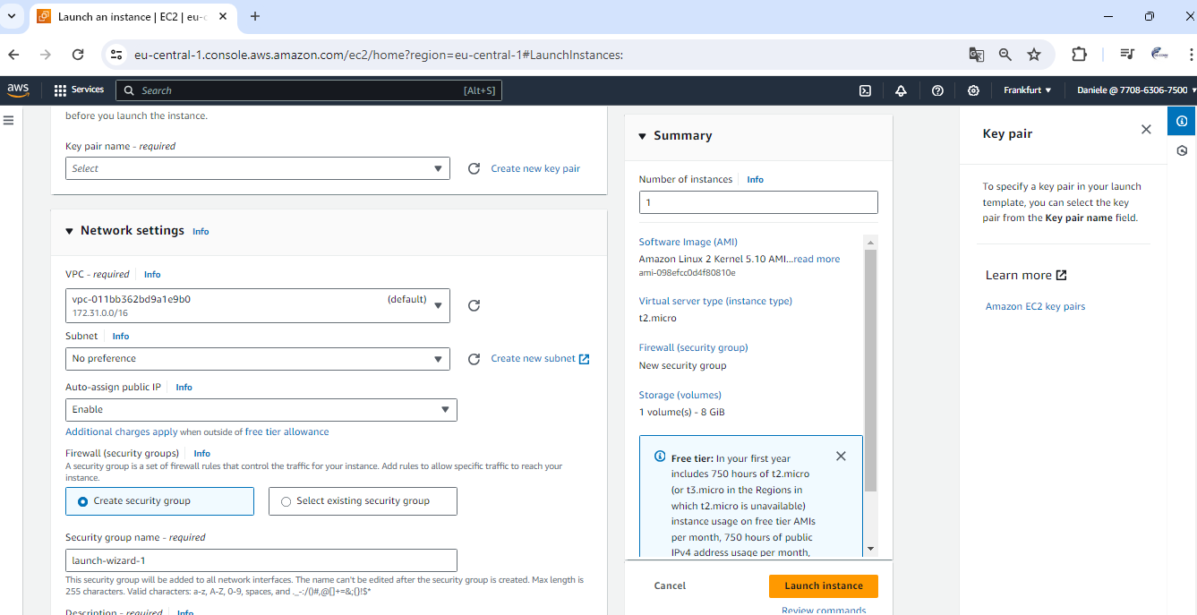
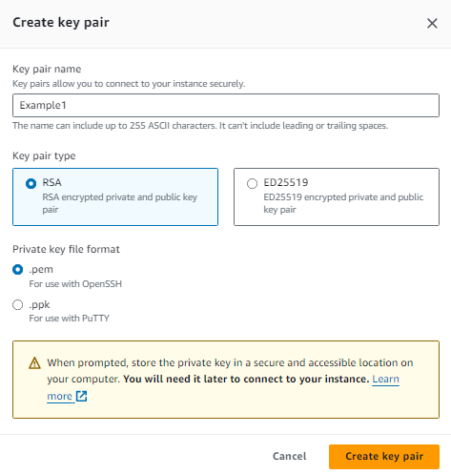
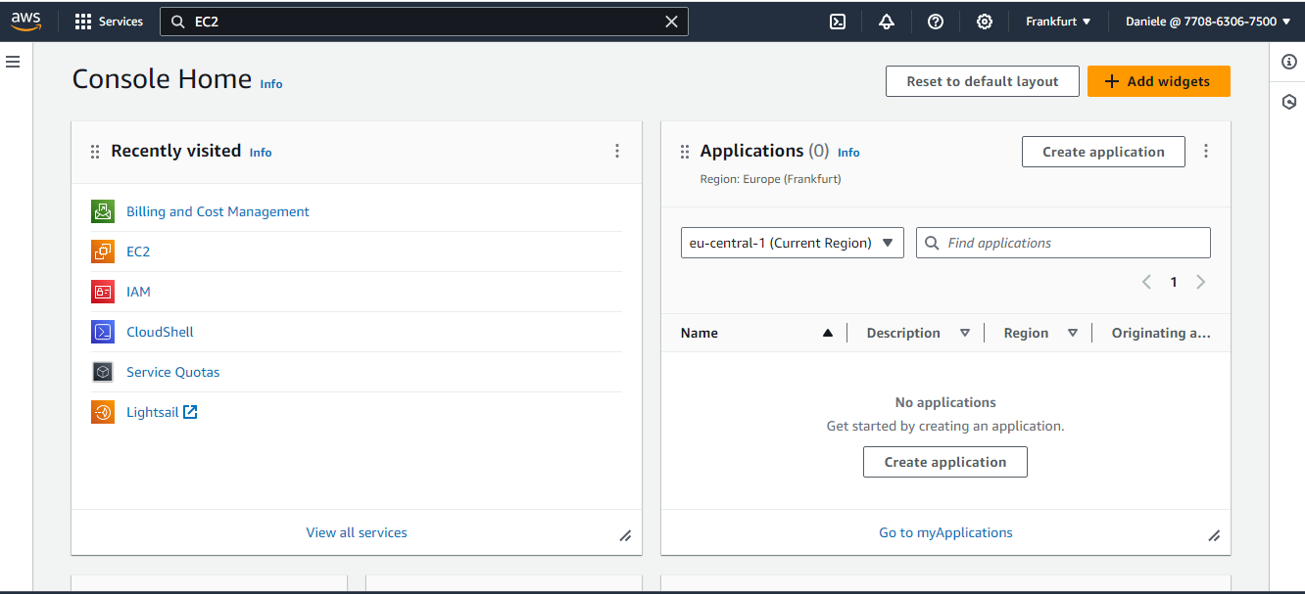

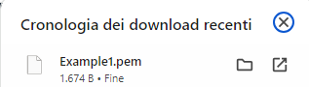
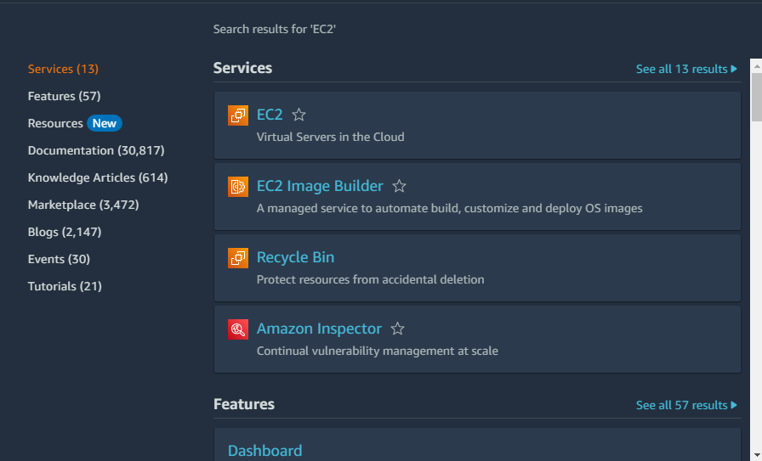
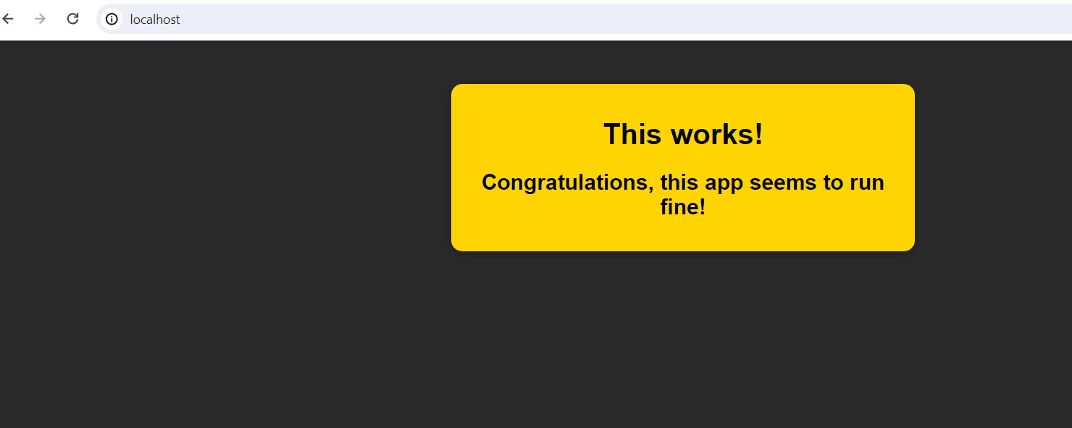

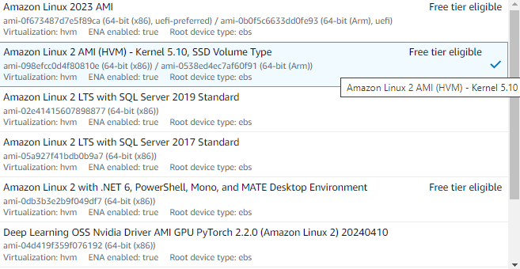

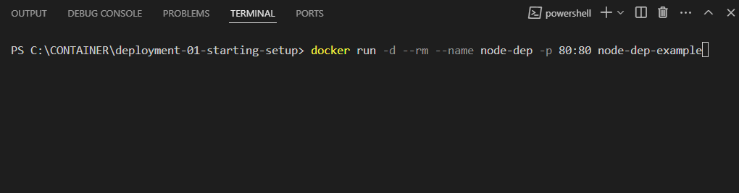
GETTING START WITH AN EXAMPLE
PLEASE OPEN in visualstudio code this folder: Deployment-01-starting-setup
Now we want to take this application and this image and deploy it onto a web server so that any user is able to visit it, and not just, we locally on our hosting machine.
Now for that, building the image is an important first step.
PLEASE CONNECT TO AWS WEBSITE….AND LOGIN
First we need need a Dockerized application….
we then need to connect to this instance,
via SSH, which stands for secure shell.
Which is a process where a certain approach for connecting to this remote machine, a terminal based approach.
Which then allows us to run commands on that remote computer and we will run a command to install Docker, and then pull and run our container.
PLEASE COPY THIS FILE ON YOUR FOLDER PROJECT
We'll then have to configure that security group
to expose all required ports to the world wide web, so that we can have incoming traffic to this EC2 instance.
The first step, will be that we create and launch this EC2 instance so this remote computer.
And we also need to create a so called VPC,
a virtual public cloud and a security group,
to control who has access to this instance.

Slide 8
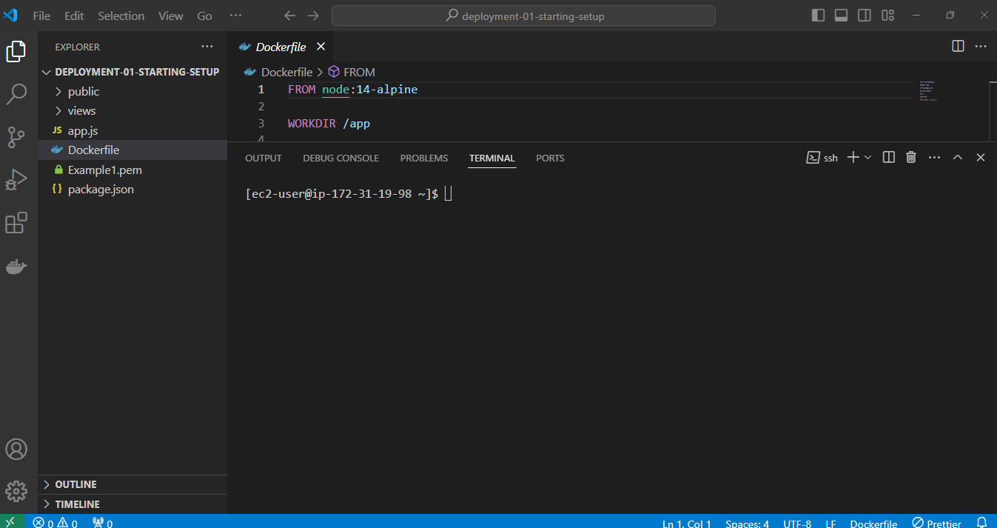
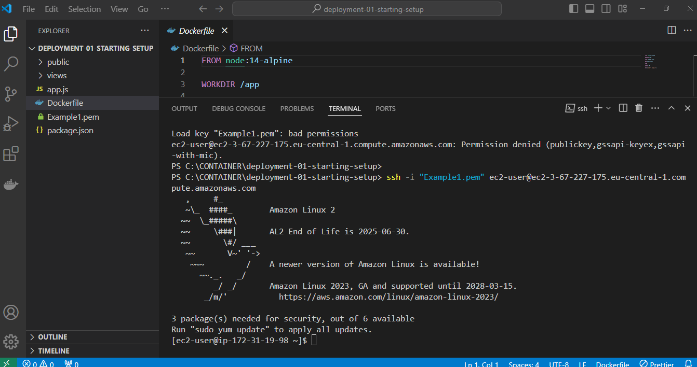
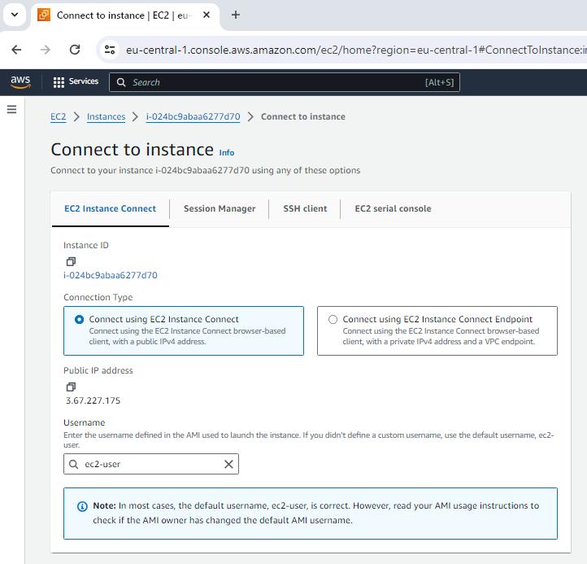
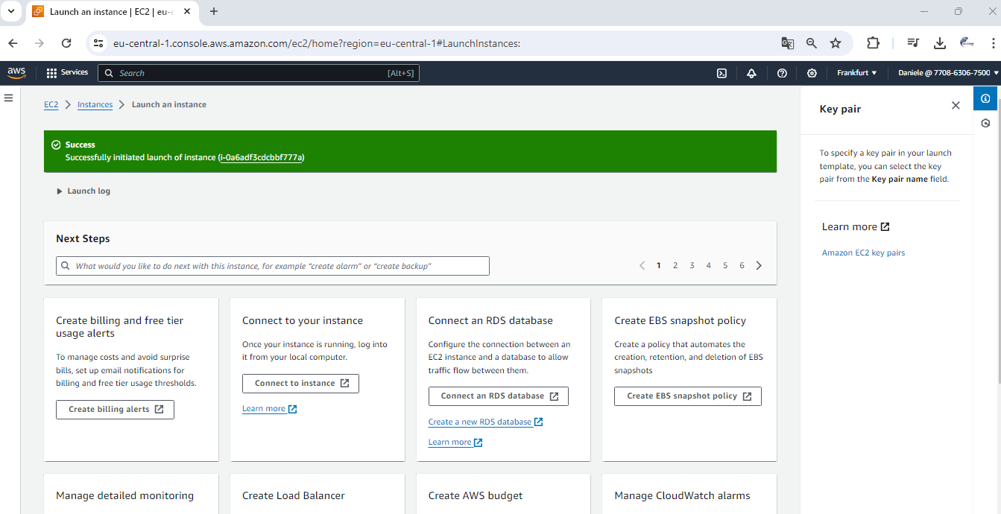
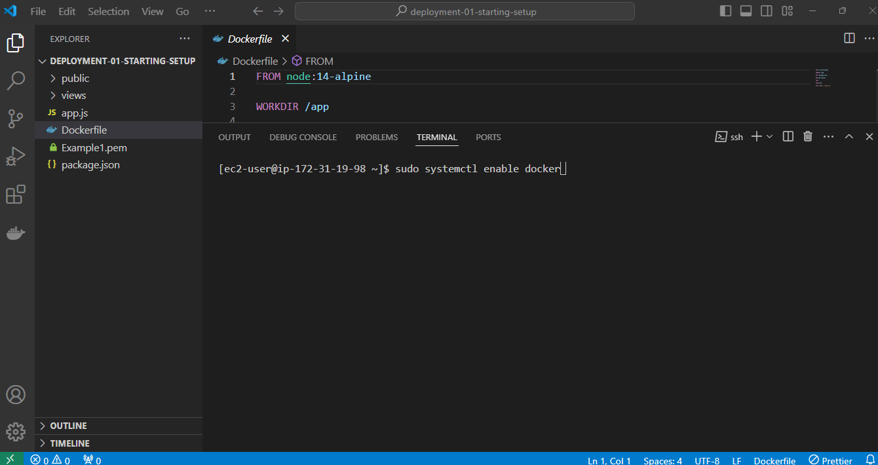
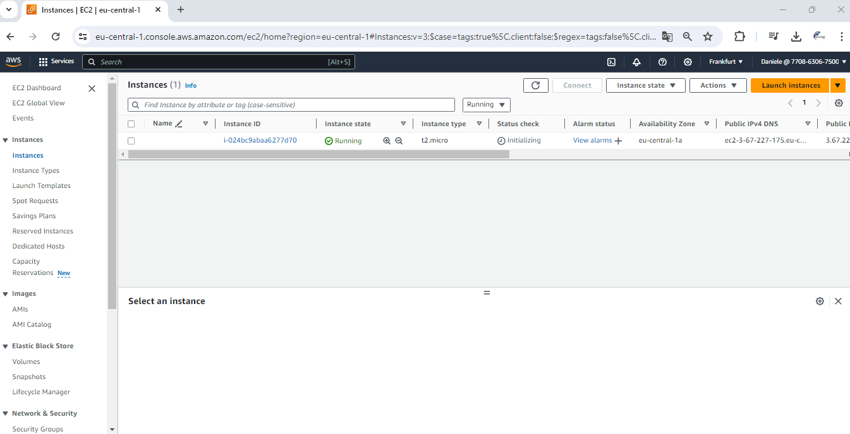
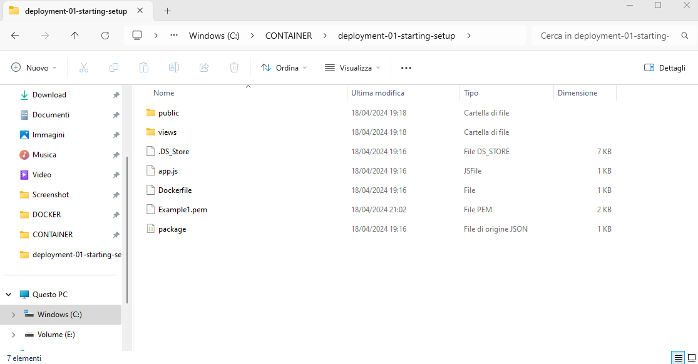
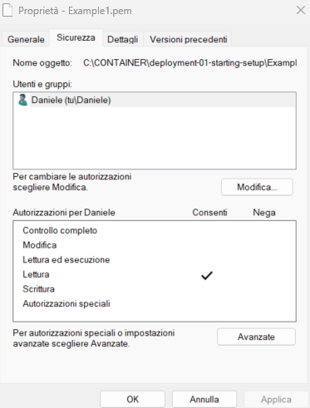
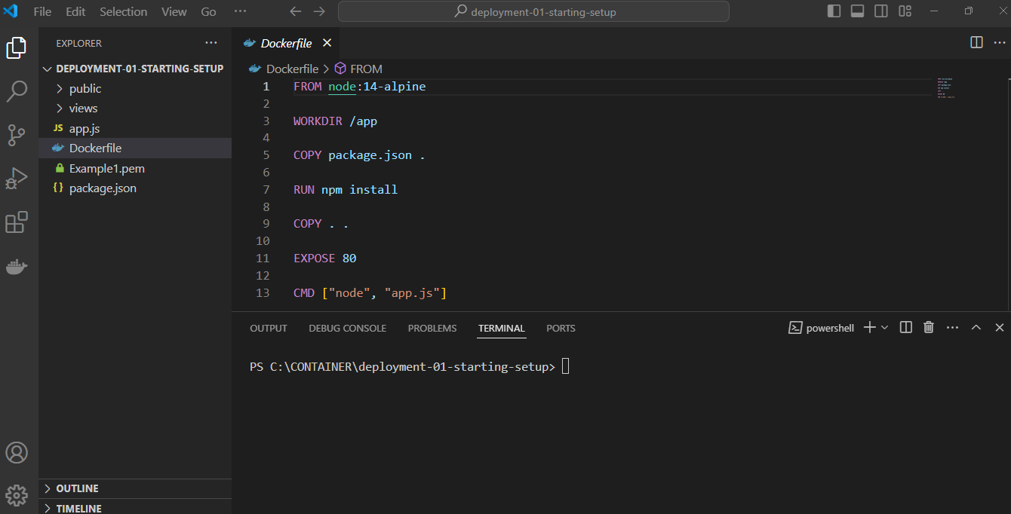
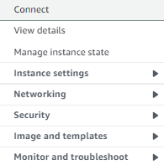
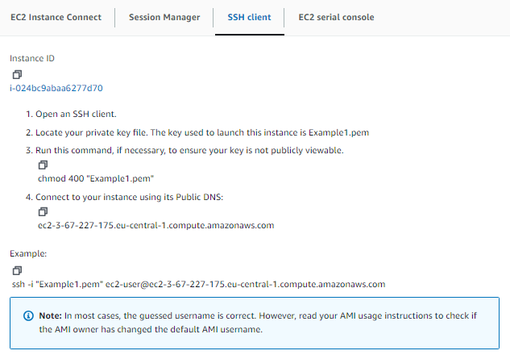
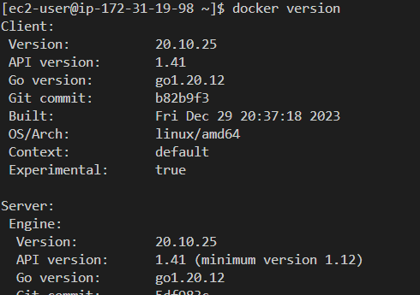
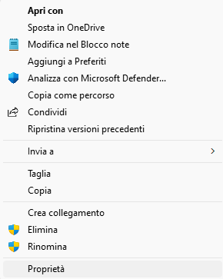
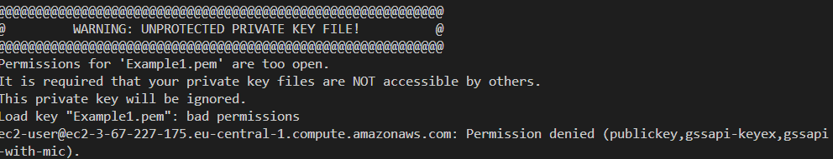
INTRODUCING AWS & EC2
Let’s proceed to install docker….

Slide 9
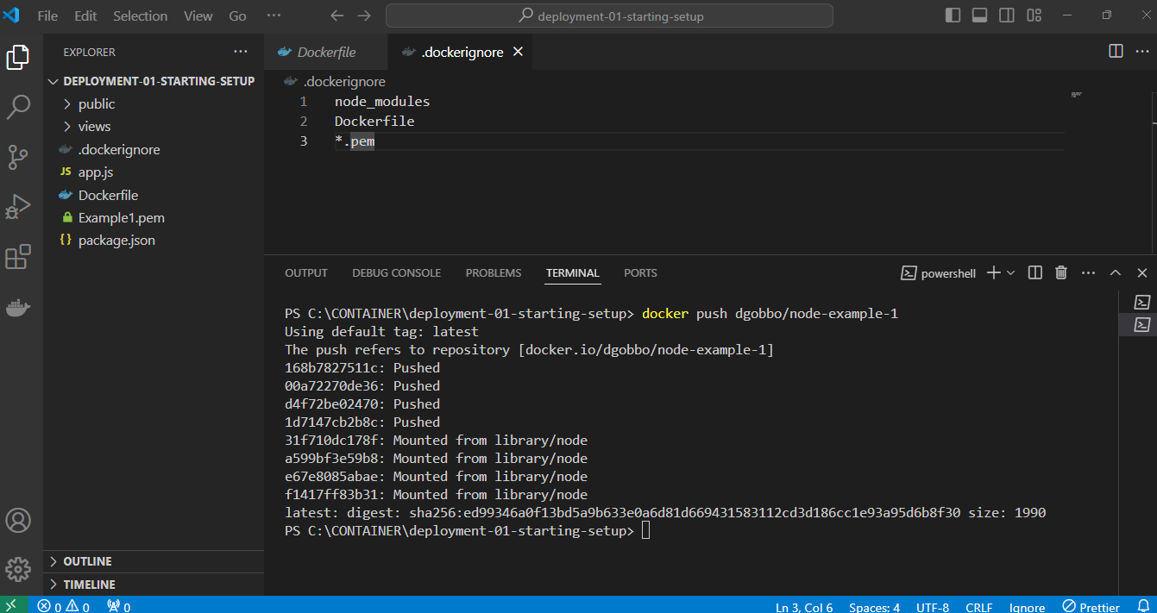
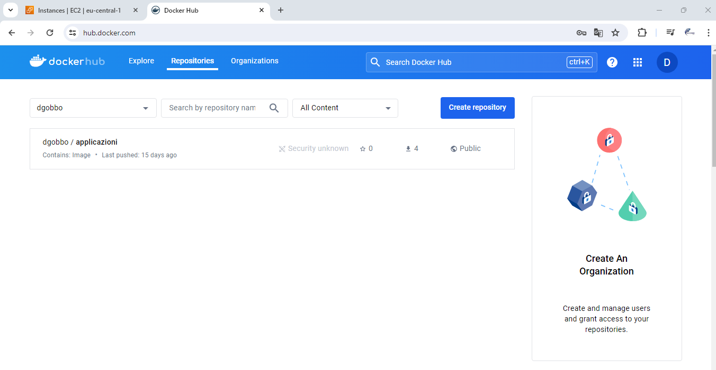
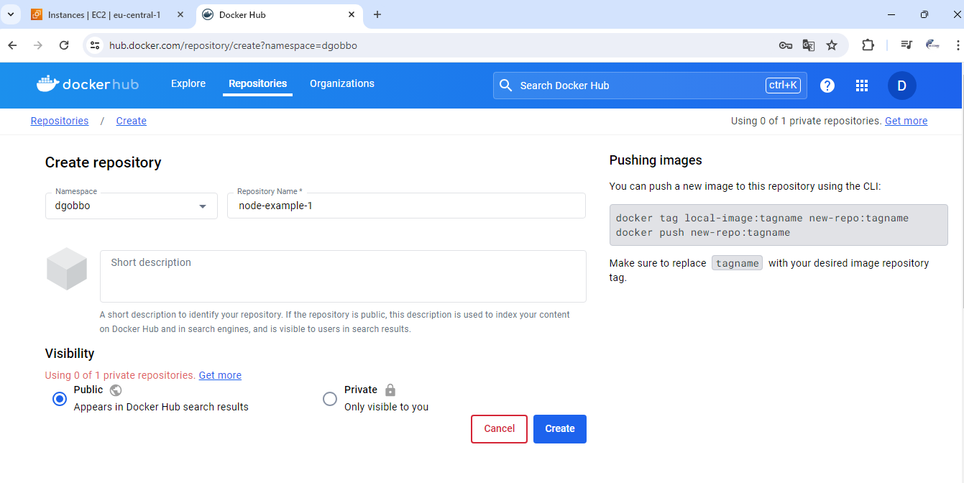










PUSHING OUR LOCAL IMAGE TO THE CLOUD
PLEASE SIGN IN ON DOCKER HUB WEBSITE

Slide 10















RUNNING & PUBLISHING THE APP ON EC2
We can see that this container is up and running here.
Now, our Dockerized Node application is not just running locally on our local host machine, but we did know started with the help of this container on a remote machine.
And now the only remaining is
how can we test it there.
This means that our locally developed application,
our Node application here, which we package up with Docker, is successfully running on a remote server.
And we didn't need to install Node.js on that remote serve
We only installed Docker on that remote EC2 instance.
we didn't need to install and configure a Node.js environment on that remote instance, we just had to install Docker and the Docker image
All outbound traffic is allowed the instance was able so the EC2 instance here was able to communicate to Docker Hub. Now for inbound rules that's different.
Here, we see all the traffic that is allowed from somewhere in the world queue this instance and here only one port openedis port 22, which is the SSH port.
IS NOT A BUG, THAT’S A SECURITY FEATURE
By default, your instance your EC2 instance,
is basically disconnected from everything
in the world wide web, so that no one is able
to connect except for you with SSH.
And this is controlled with a so called security group.
This group basically controls which traffic
is allowed on our EC2 instance.

Slide 11












MANAGING & UPDATING THE CONTAINER/IMAGE
Now still to finish up this example,
let me show you how you could push updates to your code to that remote server and how you can then stop and shut everything down if you want that to do that.
So let's start with updating the code.
Now, of course this change is not automatically reflected on the remote server.
There we still see the old version because I only made that change locally.
Now, the process of bringing these updates
to the remote server is simple, though.
We rebuild the image push it to Docker Hub again, and make sure we use this updated image on the remote server.
???????
The reason for that is that whenever you docker run an image, Docker always just checks,
whether it already has this image locally.
And if it does it just uses that.
It does not check, if there is a more up-to-date remote image available.
To ensure that we do use the latest version though, we can run docker pull manually
and simply pull this image again.
This is a possible way of deploying a Docker application.
But it will not be the final way of deploying an application with Docker.
Because it turns out that this approach,
which has showed you in great detail here,
has a couple of disadvantages and downsides

Slide 12

Disadvantages of our Current Approach
But this specific way of deploying a Docker application
has a couple of disadvantages. Because:
we had to create that instance manually,
configure it manually,
we had to connect to it manually,
install Docker on it manually,
we had to do a lot of steps on our own,
even though running the actual app
was still fairly easy in the end.

